Slide 1
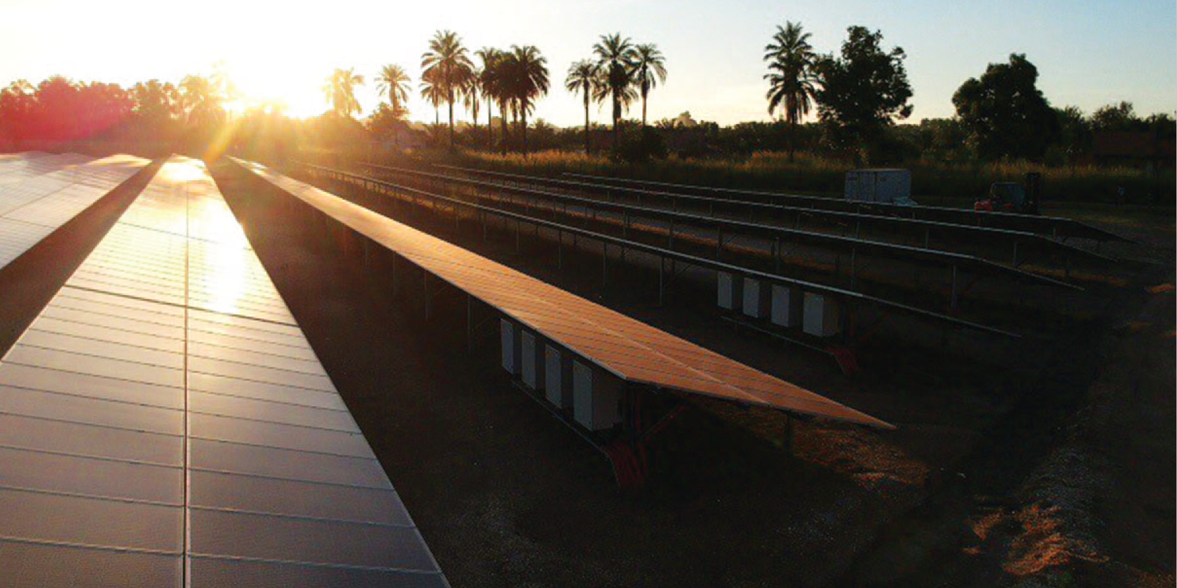
TRENDS 2023 Figures
Gaëtan Masson, Operating Agent Task 1 IEA PVPS
Milan, 29th of September 2023

Slide 2
What is IEA PVPS?
The International Energy Agency (IEA), founded in 1974, is an autonomous body within the framework of the Organization for Economic Cooperation and Development (OECD). ​
The Technology Collaboration Programme was created with a belief that the future of energy security and sustainability starts with global collaboration. The programme is made up of thousands of experts across government, academia, and industry dedicated to advancing common research and the application of specific energy technologies.
The IEA Photovoltaic Power Systems Programme (PVPS) is one of ​the Technology Collaboration Programme established within the ​International Energy Agency in 1993​
32 members - 27 countries, European Commission, 4 associations​
“To enhance the international collaborative efforts which facilitate the role of photovoltaic solar energy as a cornerstone in the transition to sustainable energy systems”

Slide 3
Disclaimer
Data for non-IEA PVPS countries are provided by official contacts or experts in the relevant countries.
Data are valid at the date of publication and should be considered as estimates in several countries due to the publication date.
Please mention our references if you use these figures.

Slide 4
ANNUAL INSTALLED VS ANNUAL SHIPPED VOLUMES AND EVOLUTION OF DATA ESTIMATIONS
PVPS

Slide 5
EVOLUTION OF CUMULATIVE PV INSTALLATIONS
PVPS

Slide 6
PV PENETRATION PER CAPITA IN 2022
PVPS

Slide 7
EVOLUTION OF ANNUAL PV INSTALLATIONS IN MAJOR MARKETS
PVPS

Slide 8
EVOLUTION OF MARKET SHARE OF TOP COUNTRIES
PVPS

Slide 9
GLOBAL PV MARKET IN 2022
PVPS

Slide 10
CUMULATIVE PV CAPACITY END 2022
PVPS

Slide 11
EVOLUTION OF REGIONAL PV INSTALLATIONS
PVPS

Slide 12
2018-2022 GROWTH PER MAJOR MARKET
PVPS

Slide 13
ANNUAL SHARE OF CENTRALISED AND DISTRIBUTED GRID-CONNECTED INSTALLATIONS 2012-2022
PVPS

Slide 14
CUMULATIVE SHARE OF GRID CONNECTED PV INSTALLATIONS 2012-2022
PVPS

Slide 15
CENTRALISED PV INSTALLED CAPACITY PER REGION 2022
PVPS

Slide 16
CENTRALISED PV CUMULATIVE INSTALLED CAPACITY PER REGION 2022
PVPS

Slide 17
DISTRIBUTED PV INSTALLED CAPACITY PER REGION 2022
PVPS

Slide 18
DISTRIBUTED PV CUMULATIVE INSTALLED CAPACITY PER REGION 2022
PVPS

Slide 19
ANNUAL GRID-CONNECTED CENTRALISED AND DISTRIBUTED PV INSTALLATIONS BY REGION IN 2022
PVPS

Slide 20
EVOLUTION OF PV INSTALLATIONS IN THE AMERICAS PER SEGMENT
PVPS

Slide 21
EVOLUTION OF PV INSTALLATIONS IN ASIA PACIFIC PER SEGMENT
PVPS

Slide 22
EVOLUTION OF PV INSTALLATIONS IN EUROPE PER SEGMENT
PVPS

Slide 23
OLUTION OF PV INSTALLATIONS IN AFRICA AND THE MIDDLE EAST PER SEGMENT
PVPS

Slide 24
PV SYSTEM VALUE CHAIN (EXAMPLE OF CRYSTALLINE SILICON PV TECHNOLOGY)
PVPS

Slide 25
SHARE OF PV POLYSILICON PRODUCTION IN 2022
PVPS

Slide 26
SHARE OF PV WAFER PRODUCTION IN 2022
PVPS

Slide 27
SHARE OF PV CELL PRODUCTION IN 2022
PVPS

Slide 28
Share of PV Module Production in 2022
PVPS

Slide 29
PV MODULE PRODUCTION PER TECHNOLOGY IN 2022
PVPS

Slide 30
YEARLY PV INSTALLATION, MODULE PV PRODUCTION AND MODULE PRODUCTION CAPACITY 2012-2022 (GW)
PVPS

Slide 31
OVERVIEW OF DOWNSTREAM SECTOR (UTILITY PV APPLICATION)
PVPS

Slide 32
CO² EMISSIONS AVOIDED BY PV
PVPS

Slide 33
AVOIDED CO² EMISSIONS AS PERCENTAGE OF ELECTRICITY SECTOR TOTAL EMISSIONS
PVPS

Slide 34
AVOIDED CO² EMISSIONS AS PERCENTAGE OF ENERGY SECTOR TOTAL EMISSIONS
PVPS

Slide 35
BUSINESS VALUE OF THE PV MARKET IN 2022
PVPS

Slide 36
CONTRIBUTION TO GLOBAL GDP OF PV BUSINESS VALUE AND ENERGY SECTOR INVESTMENTS
PVPS

Slide 37
Absolute PV industrial business value in 2022
PVPS

Slide 38
PV industrial business value along the value chain in 2022
PVPS

Slide 39
PV industrial business value as share of GDP in 2022
PVPS

Slide 40
GLOBAL EMPLOYMENT IN PV PER COUNTRY
PVPS

Slide 41
PV MDOULES SPOT PRICES LEARNING CURVE (1992-2022)
PVPS

Slide 42
EVOLUTION OF PV MODULES PRICES RANGE IN USD/W REPORTED IN IEA PVPS NATIONAL SURVEY REPORTS
PVPS

Slide 43
INDICATIVE MODULE PRICES IN REPORTING COUNTRIES
PVPS

Slide 44
2022 PV MARKET COSTS RANGES
PVPS

Slide 45
EVOLUTION OF RESIDENTIAL AND GROUND-MOUNTED SYSTEMS PRICE RANGE 2012 - 2022 (USD/W)
PVPS

Slide 46
INDICATIVE INSTALLED SYSTEM PRICES IN SELECTED IEA PVPS REPORTING COUNTRIES IN 2022
PVPS

Slide 47
LCOE OF PV ELECTRICITY AS A FUNCTION OF SOLAR IRRADIANCE & RETAIL PRICES IN KEY MARKETS*
PVPS

Slide 48
NORMALISED LCOE FOR SOLAR PV BASED ON LOWEST* PPA PRICES 2016 - Q4 2022
PVPS

Slide 49
NORMALISED LCOE FOR SOLAR PV BASED ON RECENT PPA PRICES 2022
PVPS

Slide 50
PV CONTRIBUTION TO ELECTRICITY DEMAND 2022
PVPS

Slide 51
SHARE OF RENEWABLE IN THE GLOBAL ELECTRICITY PRODUCTION IN 2022
PVPS

Slide 52
NEW RENEWABLE INSTALLED CAPACITY IN 2022
PVPS

Slide 53
EVOLUTION OF TOP 10 MARKETS
PVPS

Slide 54
TOP 10 COUNTRIES FOR CENTRALIZED PV INSTALLED IN 2022
PVPS

Slide 55
TOP 10 COUNTRIES FOR CUMULATIVE CENTRALIZED PV INSTALLED CAPACITY IN 2022
PVPS

Slide 56
TOP 10 COUNTRIES FOR DISTRIBUTED PV INSTALLED IN 2022
PVPS

Slide 57
TOP 10 COUNTRIES FOR CUMULATIVE DISTRIBUTED PV INSTALLED CAPACITY IN 2022
PVPS

Slide 58
2022 PV MARKET STATISTICS IN DETAIL
PVPS

Slide 59
GLOBAL TOP FIVE MANUFACTURERS IN TERMS OF PV CELL/MODULE PRODUCTION AND SHIPMENT VOLUME (2022)
PVPS

Slide 60
EVOLUTION OF ACTUAL MODULE PRODUCTION AND PRODUCTION CAPACITIES (MWp)
PVPS

Slide 61
TOP 10 RANKING OF PV BUSINESS VALUES
PVPS

Slide 62
TOP 10 LOWEST WINNING BIDS IN PV TENDERS FOR UTILTY SCALE PV SYSTEM
PVPS

Slide 63
LOWEST WINNING BIDS IN PV TENDERS FOR UTILTY SCALE PV SYSTEM PER REGION
PVPS

Slide 64
2022 PV ELECTRICITY STATISTICS IN IEA PVPS COUNTRIES
PVPS

Slide 65
CUMULATIVE INSTALLED PV CAPACITY (MWp) FROM 1992 TO 2022
PVPS

Slide 66
ANNUAL INSTALLED PV CAPACITY (MW) FROM 1992 TO 2022
PVPS

Slide 67
AVERAGE 2022 EXCHANGE RATES
PVPS

Slide 68
Infographic
PVPS

Slide 69
Infographic
PVPS

Slide 70
Infographic
PVPS

Slide 71
Gaëtan Masson, T1
g.masson@becquerelinstitute.eu

